Slide 1

Spiritual Gifts
Inventory Seminar
Dr. Rick Griffith • Jordan Evangelical Theological Seminary • BibleStudyDownloads.org

Slide 2
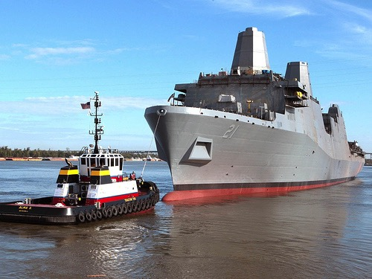
The Newest USN Ship
Notes:
I wonder how many of you have seen one of the newest US Navy ships christened on March 1.
This particular ship has several new features:
It was built with 24 tons of scrap steel
(THE POINT: God has remade our lives from brokenness: The USS New York with WTC steel parallels our destroyed lives made into Christ's body of which we are a part. See http://www.ussny.org/ and http://www.snopes.com/photos/military/ussnewyork.asp)

Slide 3
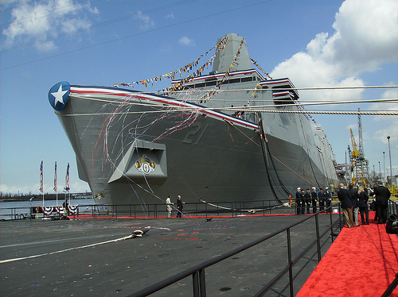
Docked
Notes:
It is the fifth in a new class of warship - designed for missions that include special operations against terrorists. It will carry a crew of 360 sailors and 700 combat-ready Marines to be delivered ashore by helicopters and assault craft.

Slide 4
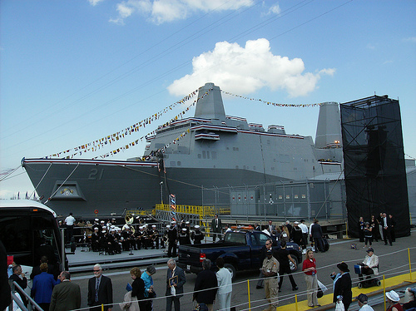
Made from WTC
Notes:
Definitely the most unique feature of this ship is that it is built entirely of scrap metal—and that metal comes directly from… yes, you guessed it—the Twin Towers in New York City!

Slide 5
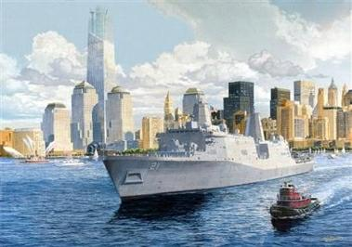
USS New York
Notes:
In fact, the ship is called the USS New York.
Of its 24 tons, 7.5 came from the World Trade Center and was melted down in a foundry in Avondale, LA to cast the ship's bow section.

Slide 6
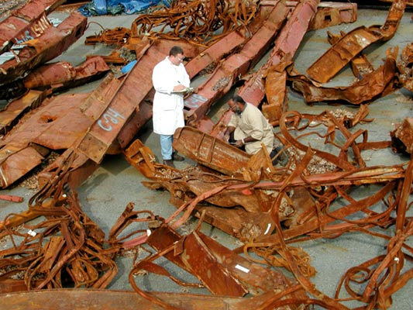
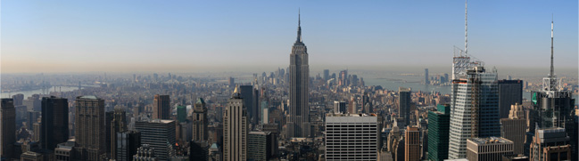
WTC Scraps
Notes:
Junior Chavers, foundry operations manager, said that when the trade center steel first arrived, he touched it with his hand and the 'hair on my neck stood up.' 'It had a big meaning to it for all of us,' he said. 'They knocked us down. They can't keep us down. We're going to be back.'

Slide 7
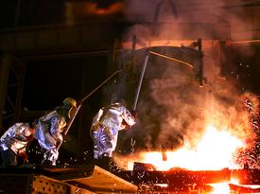
Amite Foundry
Notes:
When it was poured into the molds on Sept 9, 2003, 'those big rough steelworkers treated it with total reverence,' recalled Navy Capt. Kevin Wensing, who was there. 'It was a spiritual moment for everybody there.' Here three veteran employees of Amite Foundry open the ladle containing tons of molten steel from the World Trade Center.

Slide 8
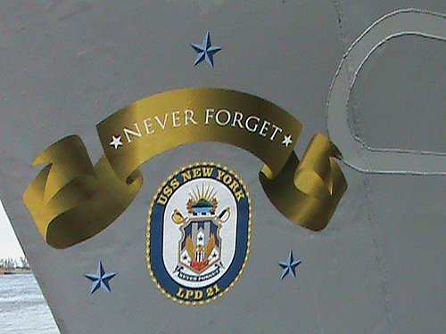
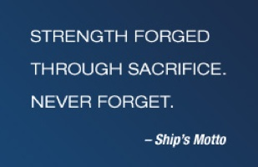
Never Forget
Notes:
The ship's motto is blazoned on the side: “Never Forget'!” It will officially be commissioned in NYC in Fall 2009.

Slide 9

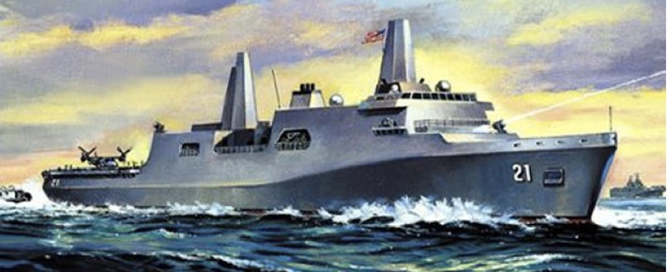
Parallels
Notes:
1. As I thought about the upcoming seventh commemoration of 9/11 and this ship made from remnants of destruction, the parallel to our lives as Christians really hit me.
a) Like the Twin Towers, we also were made beautiful for a grand purpose in Eden.
b) Like those Twin Towers, we also became remnants of destruction back in Eden.
c) Like the World Trade Center recycled into a useful vessel against aggressors, so as believers in Christ, He has made us a new body in Christ to battle the enemy.
Each part of that ship has a specific purpose; likewise, because we are in Christ, the Holy Spirit has assigned each of us a new role to play in the body of Christ.

Slide 10

How do you see the Spirit working in your life?
Notes:
Intro to MPI: But do you identify with this? How do you see the Spirit working in your life?

Slide 11
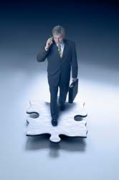

One evidence of the Spirit's work in your life is your spiritual gift
(1 Cor. 12:7-11)
“A spiritual gift is given to each of us so we can help each other” (1 Cor. 12:7 NLT)

Slide 12

How to Discern Spiritual Gifts in Yourself and Others
60

Slide 13
Break
Notes:
13

Slide 14
The Wayward Local Church
The Wayward Local Church
Reports
Questions
Division
Disorder
Difficulties
Concern
1–4
Discipline
5–6
Instruction
7–16
Incest 5
Marriage 7
Gifts 12–14
Women 11
Factions 1–2
Immorality
Idols 8–10
Collection 16
Carnality 3–4
Lawsuits 6
Resurrect 15
Solving church problems theologically

Slide 15
The Triune Involvement in the Gifts
(1 Cor. 12:4-6)
EMPOWERS
Father
is
is not
is not
GOD
is
is
Son
Spirit
APPOINTS
GIVES
is not
H. Wayne House, Charts of Christian Theology and Doctrine, 45

Slide 16

The Spirit gives every gift (8)
⁸To one person the Spirit gives the ability to give wise advice [a word of wisdom]; to another the same Spirit gives a message of special knowledge [a word of knowledge].*

Slide 17
The Spirit gives every gift (9-10a)
⁹The same Spirit gives great faith to another, and to someone else the one Spirit gives the gift of healing. ¹⁰He gives one person the power to perform miracles.

Slide 18
The Spirit gives every gift (10b-11a)
and another the ability to prophesy. He gives someone else the ability to discern whether a message is from the Spirit of God or from another spirit. Still another person is given the ability to speak in unknown languages,* while another is given the ability to interpret what is being said. ¹¹It is the one and only Spirit who distributes all these gifts.

Slide 19
The Spirit alone chose the gift you got (11b)
He alone decides which gift each person should have.

Slide 20
Overview and Categorization of the Gifts Chart
17
SPIRITUAL GIFTS | APOSTLESHIP | PROPHECY | TEACHING | EVANGELISM | PASTOR-TEACHER | EXHORTATION |  | ADMINISTRATIONS | FAITH | GIVING | SERVICE (HELPS) | SHOWING MERCY | DISTINGUISHING SPIRITS | WORD OF WISDOM | WORD OF KNOWLEDGE | SPEAKING IN TONGUES | INTERPRETING TONGUES | MIRACLES | HEALINGS
Duration | Temporary |  | Permanent |  |  |  |  |  |  |  |  |  | Temporary
Words | Verbal |  |  |  |  |  |  | Non-Verbal |  |  |  |  | Verbal |  |  |  |  | Non-Verb
Focus | Speaking |  |  |  |  |  |  | Serving |  |  |  |  | Signifying
Category | Support |  |  |  |  |  | Service |  |  |  |  |  | Sign
Need Met | Word Taught |  |  |  |  |  | Personal Needs |  |  |  |  |  | Word Validated
Result | Leadership |  |  |  |  |  | Healthy Body Life |  |  |  |  |  | Founding the Church
Nature | Public (to many) |  |  |  |  |  | Private (to few) |  |  |  |  |  | Public (to many)
Visibility | High |  |  |  |  |  | Low |  |  |  |  |  | High
Perceived | With Honor |  |  |  |  |  | Without Honor |  |  |  |  |  | With Honor
Minister | To the Body |  |  |  |  |  | Within the Body |  |  |  |  |  | To the Body & World
Purpose to | Equip Saints |  |  |  |  |  | Encourage Saints |  |  |  |  |  | Authenticate Saints

Slide 21
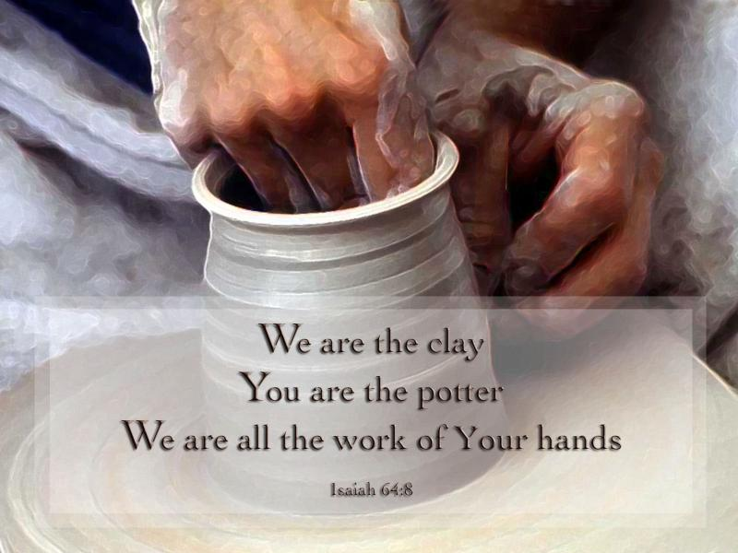
We should use our gifts by speaking for God or serving in His strength (1 Pet. 4:10-11).

Slide 22

1 Peter 4:10 (NIV)
“Each one should use whatever gift he has received to serve others, faithfully administering God's grace in its various forms.”

Slide 23
1 Peter 4:11 (NIV)
“If anyone speaks, he should do it as one speaking the very words of God. If anyone serves, he should do it with the strength God provides, so that in all things God may be praised through Jesus Christ. To him be glory forever and ever. Amen.”

Slide 24

Speaking & Serving Gifts the Spirit definitely Gives Today
Dr. Rick Griffith • Jordan Evangelical Theological Seminary • BibleStudyDownloads.org

Slide 25

Categories of Gifts
(1 Peter 4:11)
Get
words
from
God
Get
strength
from
God
47
Speaking | Serving
Teaching | Administering
Evangelism | Faith
Pastor-Teacher | Giving
Encouraging | Service
 | Mercy
Notes:
25

Slide 26
The Speaking Gifts

Slide 27

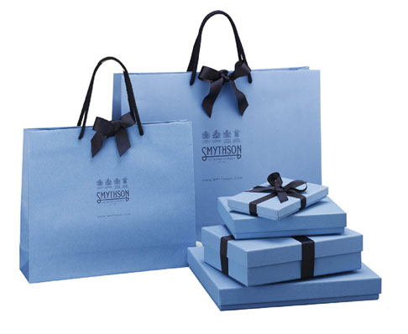
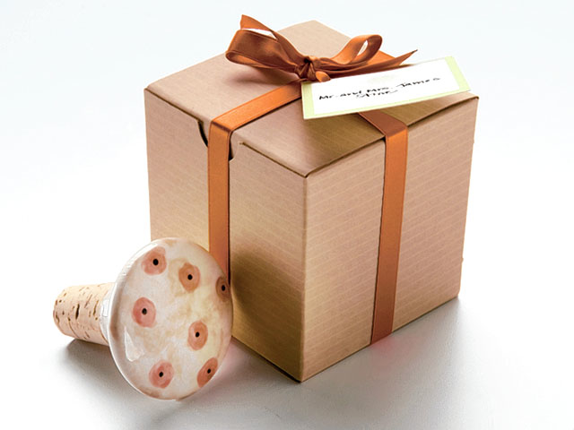
God gave some believers a speaking gift to be His special voice
I know. That's why I share my faith!
God says to use your gift
We use our mouths for Him too!

Slide 28
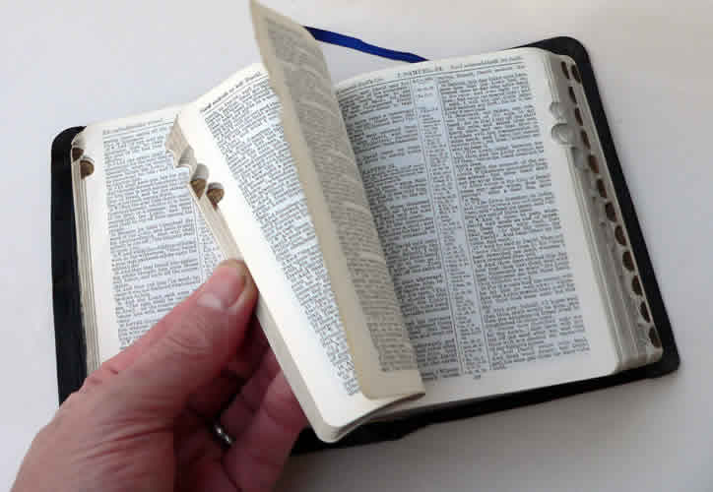
Romans 12:6-7 NLT
⁶In his grace, God has given us different gifts for doing certain things well. So if God has given you the ability to prophesy, speak out with as much faith as God has given you.
⁷If your gift is serving others, serve them well. If you are a teacher, teach well.

Slide 29

Teaching
49
"All Scripture is inspired by God and is useful to teach us what is true and to make us realize what is wrong in our lives. It corrects us when we are wrong and teaches us to do what is right. ¹⁷God uses it to prepare and equip his people to do every good work"
(2 Tim. 3:16-17 NLT)

Slide 30

Defining “Teaching”
Spiritual Gifts Inventory Questions (pp. 60-61) w/ "Q"
49
Q1
Q10
Q19
Q28
Q37
Q46
Q55
Q64
Q73
Q82
“The ability to communicate the Scriptures with clarity, ease, wisdom, and efficiency… explains God's Word with understanding"
(Swindoll, 4)

Slide 31
Serve in proportion to your faith (Rom. 12:3 NLT)
"Because of the privilege and authority God has given me, I give each of you this warning: Don't think you are better than you really are. Be honest in your evaluation of yourselves, measuring yourselves by the faith God has given us."

Slide 32
Ephesians 4:11 (NIV)
It was he who gave
some to be apostles,
and some to be prophets,
and some to be evangelists,
and some to be pastors and
teachers.

Slide 33
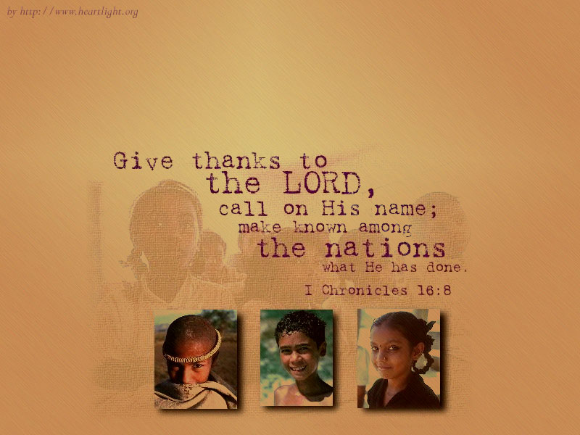
1. Evangelists reach people for Christ
50
Q2
Q11
Q20

Slide 34
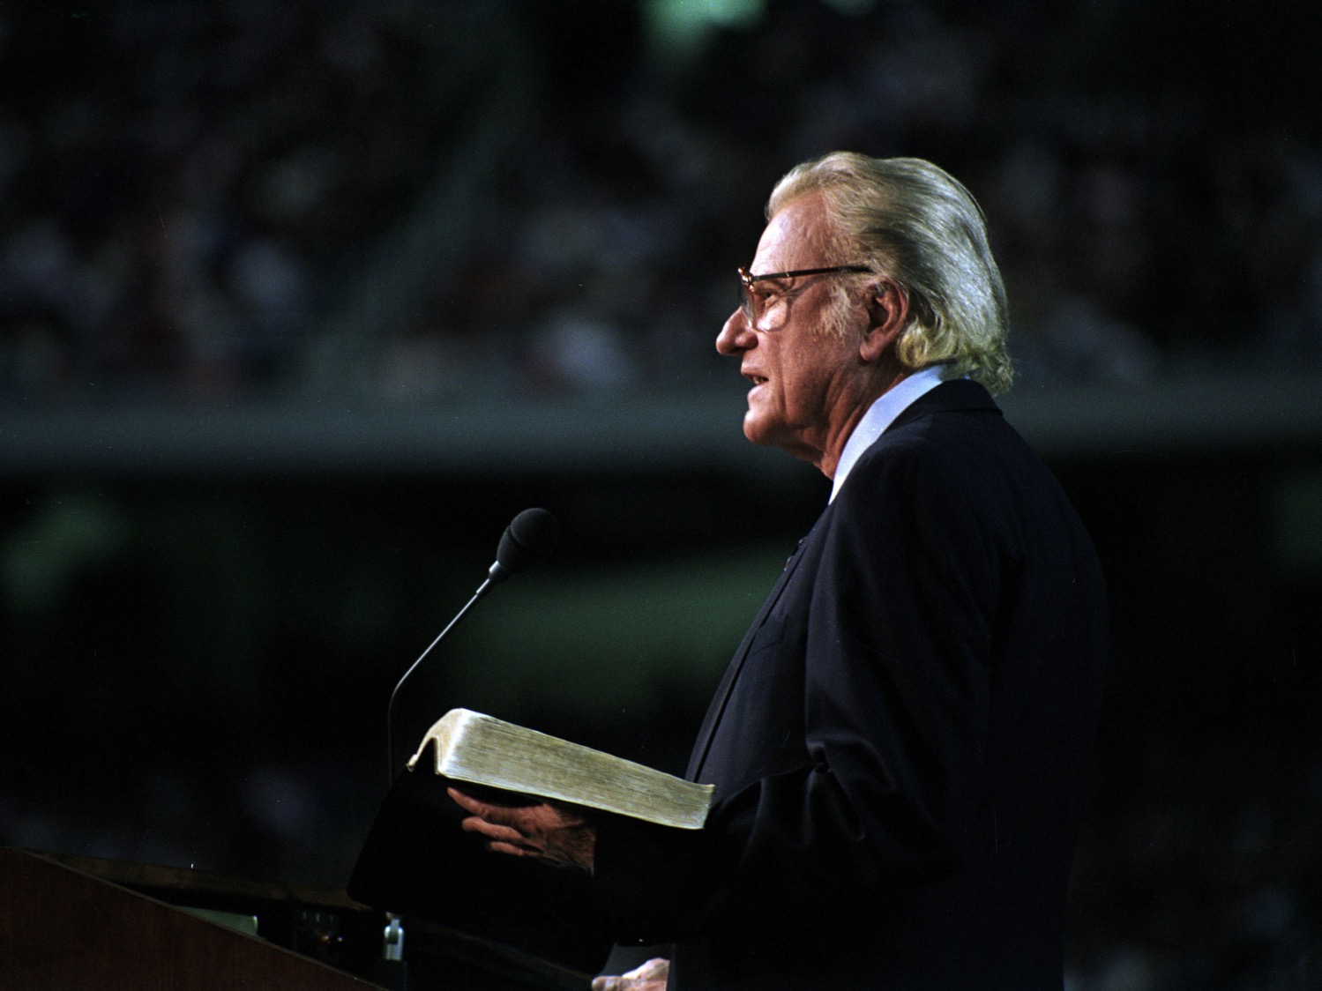
Evangelists
Q29
Is Billy Graham the standard?

Slide 35

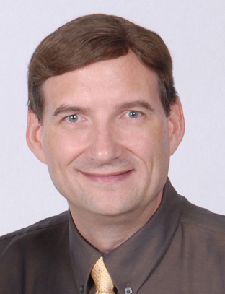
2. Evangelists equip the church to reach the lost (Eph. 4:11)
Q38
Q47
Q56
Dr Dave Geisler
President
Meekness & Truth Ministries

Slide 36
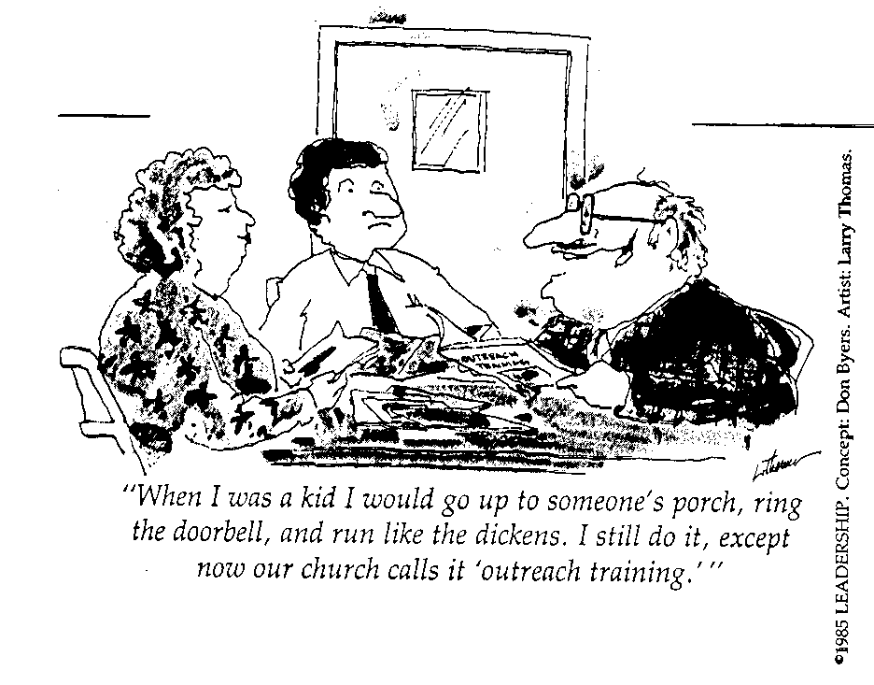
Many Fear Evangelism!
Q65
Q74
Q83
"When I was a kid I would go up to someone's porch, ring the doorbell, and run like the dickens. I still do it, except now our church calls it 'outreach training.'"

Slide 37
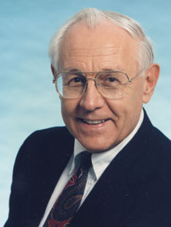
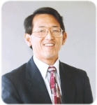
Pastor-Teachers
52
Q3
Q12
Too often we think only of those with the position of pastor-teacher

Slide 38
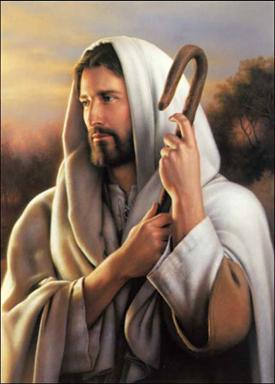
Christ is the Good Shepherd
Q21
Q30

Slide 39
The Dual Gift
And He gave
some, apostles;
and (de) some, prophets;
and (de) some, evangelists;
and (de) some, pastors and (kai,) teachers
[
[

Slide 40
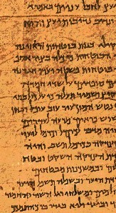
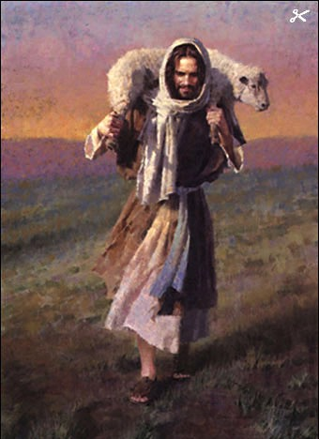
The Only “Dual” Gift
52
Pastor
Teacher
Q39
Protection
Study
Discipline
Instruction
Q57
Leading
Applying
Q48
Caring
Warning
Q66

Slide 41
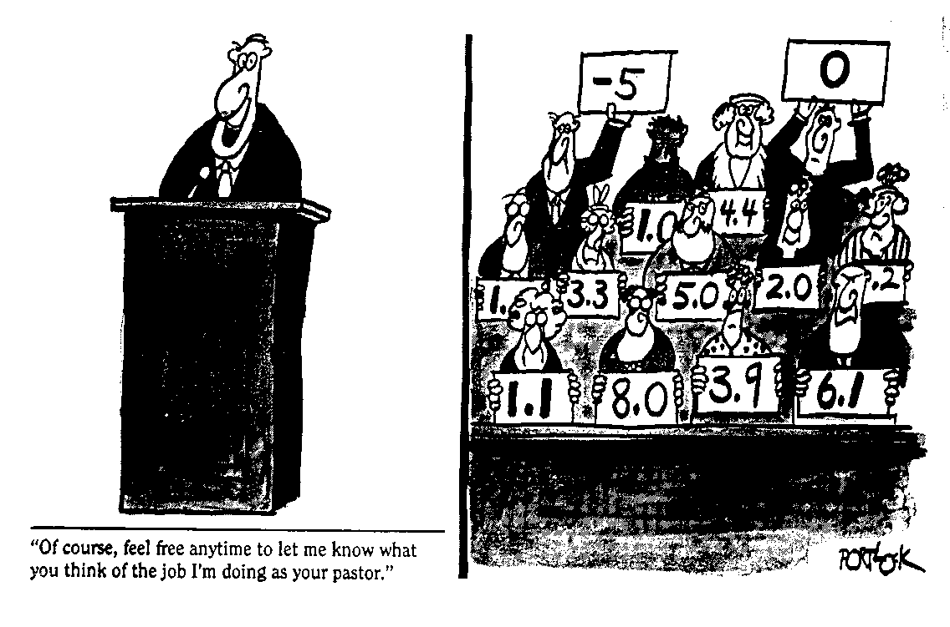
Toughest Job in the World
Q75
Q84
“Of course, feel free anytime to let me know what you think of the job I'm doing as your pastor.”

Slide 42
Ephesians 4:11-12 (NIV)
v. 11
NIV
It was he who gave
some to be apostles,
and some to be prophets,
and some to be evangelists,
and some to be pastors and teachers.
v. 12
NIV
to prepare God's people
for works of service
so that the body of Christ may be built up.
God gave gifted men to train others to do ministry!

Slide 43
Romans 12:8 NLT
Q4
⁸If your gift is to encourage others, be encouraging.

Slide 44

Encouragers should encourage others to apply God's Word (8a)
53
Q13
Q22

Slide 45

Exhortation
53
Q31
Also called the gift of encouragement

Slide 46
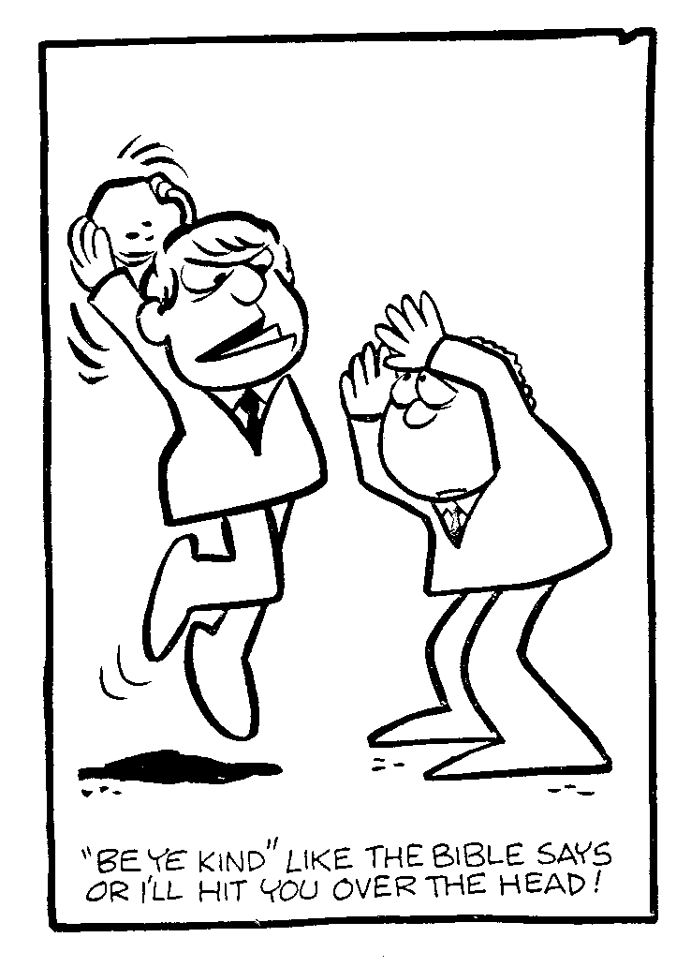
Exhortation?
Q40
"Be ye kind" like the Bible says or I'll hit you over the head!

Slide 47
Defining “Encouraging”
Q49
Q58
“While the teacher communicates facts and truths of the Word of God, the exhorter is able to encourage the hearer to act upon that which he has heard. The teacher gives the what of the Scripture, while the exhorter gives the how”
(Swindoll, 4)

Slide 48
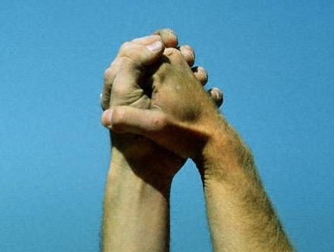
What are encouragers like?
Action steps
Q67
Application
Q67
Optimism
Q76
Believes in you
Q85

Slide 49
Joseph in Acts
Barnabas: "Son of Encouragement"
Barnabas endorsed Saul, an unwelcome convert (Acts 9:26-28; Gal. 2:9)
Barnabas accepted alien believers, the Gentiles (Acts 11:19-24)
Barnabas enlisted and developed Paul, a promising teacher (Acts 11:25-26; 12:25; 13:42ff)
Barnabas restored Mark, the youthful deserter (Acts 13:13; 15:36-41; 2 Tim. 4:11)

Slide 50
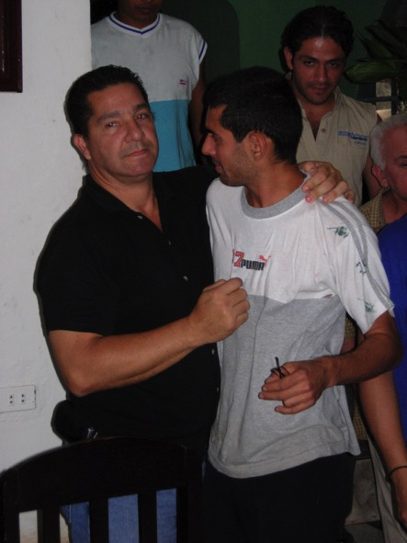
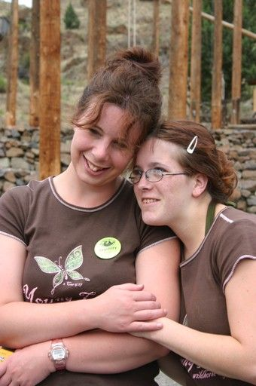

How are you doing at encouraging?
53

Slide 51

Life Transformation Groups
The Commitment: Meet one hour a week with 1-2 others of the same sex to provide accountability to:
Read 3 Bible chapters daily
Confess sin around 10 questions
Pray for lost friends

Slide 52


Discipleship

Slide 53



Life Transformation Groups

Slide 54
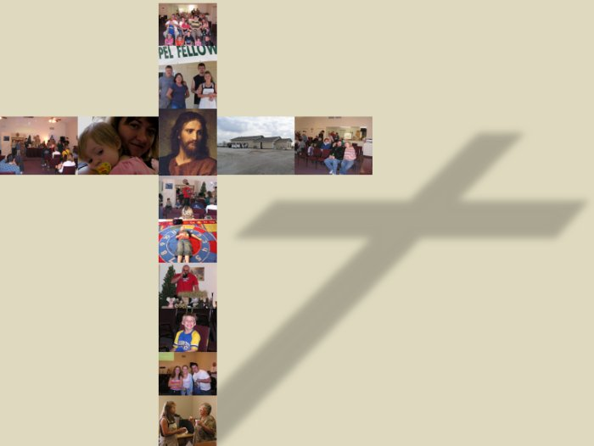
The Main Idea
Those with speaking gifts should talk as God's voice

Slide 55
Speaking Gifts Contrasted
47
 | Teaching | Evangelism | Pastor-Teacher | Exhortation
Shares | Biblical Learning | Faith & Testimony | Heart & Bible | Optimism
Recipient Need Met | Scriptural Truth | Salvation & Equipping for Evangelism | Shepherding | Encouragement
Sensitive to Needs | Doctrinally | For Conversion | Spiritually (overall needs) | Spiritually (specific needs)
Ministers to Those Needing | Instruction | Saving Faith | General Spiritual Direction | Urging in Practical Steps
General Trait | Accuracy in the Word | Heart for the Lost | Shepherd Heart | Uplifts Others

Slide 56

Scriptural Gift Commands
4
Teaching
Col. 3:16-- “Let the word of Christ richly dwell within you… teaching… one another…”
Evangelism
Matt. 28:19-- “Go therefore and make disciples of all nations…”
Pastor-
Teacher
Gal. 6:1-- “Brothers, if a man is caught in any trespass, you who are spiritual, restore him…”
Exhortation
Heb. 3:13a-- “But encourage one another daily…”

Slide 57
Break
Notes:
57

Slide 58
The Serving Gifts
Notes:
58

Slide 59
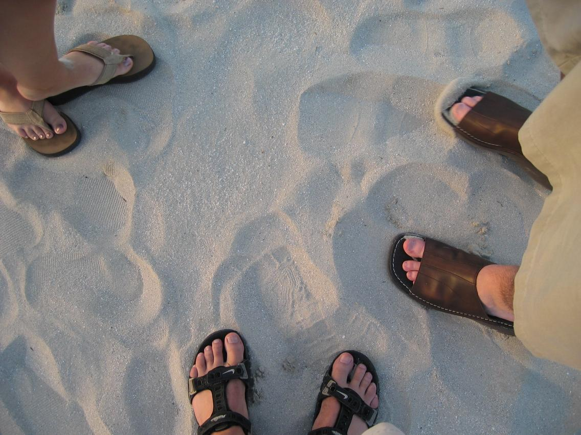
What do you think of when you think of feet?
Notes:
59

Slide 60
The Body of Christ

Slide 61

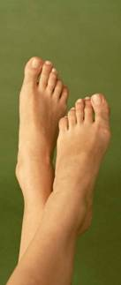
What do you think of when you think of feet?
“Unfragrant?”
“Unattractive?”
“Unenvied?”
“Unneeded?”
Notes:
61

Slide 62
1 Peter 4:11 (NIV)
47
“If anyone speaks, he should do it as one speaking the very words of God. If anyone serves, he should do it with the strength God provides, so that in all things God may be praised through Jesus Christ. To him be glory forever and ever. Amen.”
Notes:
62

Slide 63
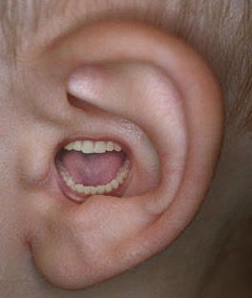
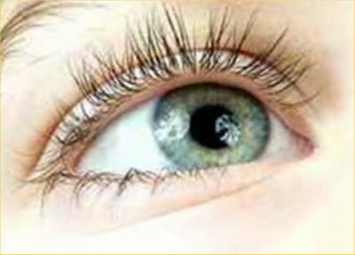
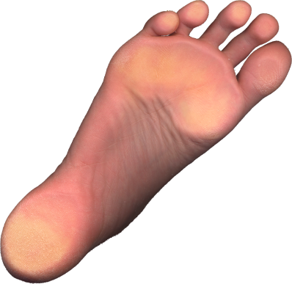
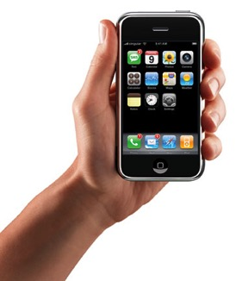

Believers with less honored gifts shouldn't feel unneeded (1 Cor. 12:15-16).
¹⁵ If the foot should say,
"Because I am not a hand, I do not belong to the body,"
it would not for that reason cease to be part of the body.
¹⁶ And if the ear should say,
"Because I am not an eye, I do not belong to the body,"
it would not for that reason cease to be part of the body.

Slide 64
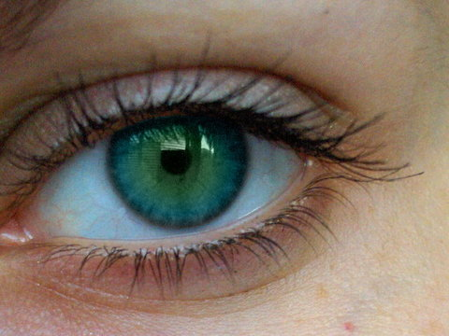
Diversity in the church makes it more effective (1 Cor. 12:17-20).
¹⁷If the whole body were an eye, where would the sense of hearing be? If the whole body were an ear, where would the sense of smell be? ¹⁸But in fact God has arranged the parts in the body, every one of them, just as he wanted them to be. ¹⁹If they were all one part, where would the body be? ²⁰As it is, there are many parts, but one body.

Slide 65

The gift of faith
Notes:
65

Slide 66


The gift of tongues
Notes:
66

Slide 67
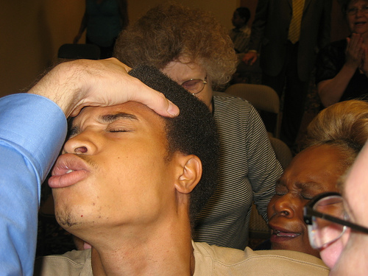
Just like the whole church being an "eye," some churches want everyone to have the same gift––usually tongues!
Notes:
67

Slide 68
The hierarchy of members shows that all don't have the same gifts
(1 Cor. 12:28-30).
And in the church God has appointed
first of all apostles,
second prophets,
third teachers,
then workers of miracles,
also those having gifts of healing,
those able to help others,
those with gifts of administration,
and those speaking in different kinds of tongues.
Are all apostles? Are all prophets? Are all teachers?
Do all work miracles? Do all have gifts of healing?
Do all speak in tongues? Do all interpret?
Notes:
68

Slide 69
Categories of Gifts
(1 Peter 4:11)
Get
words
from
God
47
Speaking | Serving
Teaching | Administering
Evangelism | Faith
Pastor-Teacher | Giving
Encouraging | Service
 | Mercy
Notes:
69

Slide 70

Speaking Gifts Contrasted
47
 | Teaching | Evangelism | Pastor-Teacher | Exhortation
Shares | Biblical Learning | Faith & Testimony | Heart & Bible | Optimism
Recipient Need Met | Scriptural Truth | Salvation & Equipping for Evangelism | Shepherding | Encouragement
Sensitive to Needs | Doctrinally | For Conversion | Spiritually (overall needs) | Spiritually (specific needs)
Ministers to Those Needing | Instruction | Saving Faith | General Spiritual Direction | Urging in Practical Steps
General Trait | Accuracy in the Word | Heart for the Lost | Shepherd Heart | Uplifts Others
Notes:
70

Slide 71
Categories of Gifts
(1 Peter 4:11)
Get
words
from
God
Get
strength
from
God
47
Speaking | Serving
Teaching | Administering
Evangelism | Faith
Pastor-Teacher | Giving
Encouraging | Service
 | Mercy
Notes:
71

Slide 72
1 Peter 4:11 Main Idea
“If anyone serves, he should do it with the strength God provides, so that in all things God may be praised through Jesus Christ. To him be glory forever and ever. Amen.”
Those with a serving gift should serve in God's strength for God's glory
How?
Notes:
72

Slide 73


Administrations
55
Q14
Meets organizational needs
Also called:
Administration
Government(s)
Leadership
Leading
Ruling
Management
Organization
Notes:
73

Slide 74
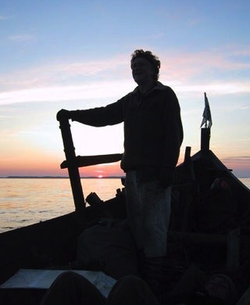


Administrations
55
Q23
1 Corinthians 12:28
kubernesis kubernh,sij
“a governing, government” (Thayer)
Related to kubernetes kubernh,tej (noun)
“captain, steersman, pilot” (Acts 27:11; Rev. 18:17; BAGD)
Notes:
74

Slide 75
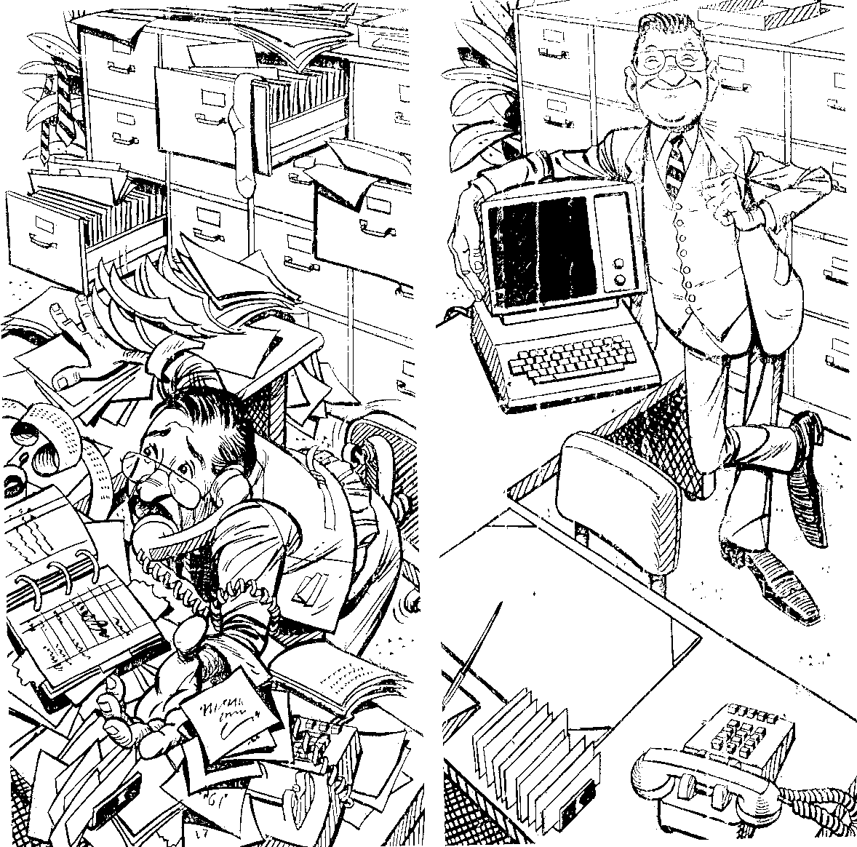
Wrong Admin View
Q5
Notes:
75

Slide 76

Two Gifts or One?
55
Q32
Leadership
Administrations
Romans 12:8
proistemi proi[sthmi
pro “before” +
histemi “to stand”
“to stand before…
be at the head (of),
rule, direct…
manage, conduct”
(BAGD)
1 Corinthians 12:28
kubernesis kubernh,sij
“a governing, government” (Thayer)
Related to kubernetes kubernh,tej (noun)
“captain, steersman, pilot” (Acts 27:11; Rev. 18:17; BAGD)
Notes:
76

Slide 77
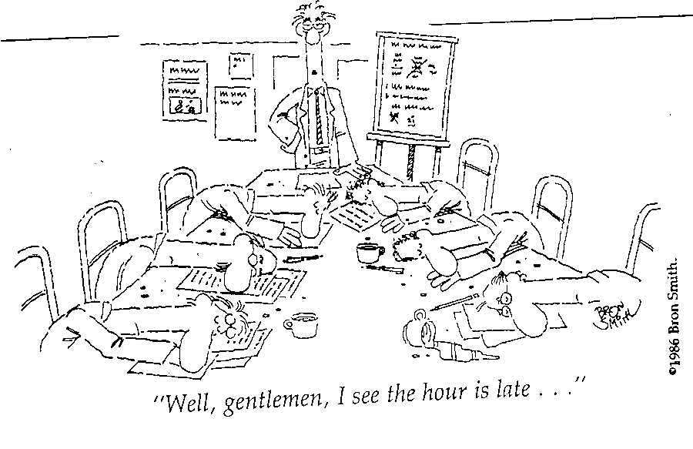
Meetings Led by the Ungifted
Q68
Q77
Q86
Q41
Q50
Q59
"Well, gentlemen, I see the hour is late…"
Notes:
77

Slide 78
What do you think of when you think of feet?
“Unfragrant?”
“Unattractive?”
“Unenvied?”
“Unneeded?”
Administrations
Faith
Giving
Service
Showing Mercy
1 Cor. 12:15, 20-22
Rom. 12:6-8
Notes:
78

Slide 79
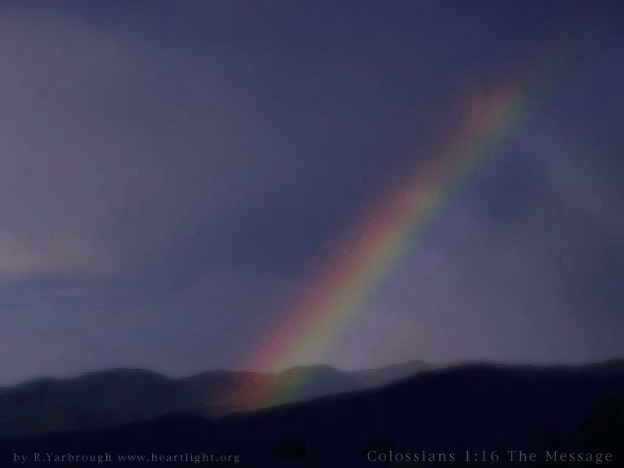
Faith
56
Q14
Providing vision
for the saints
Notes:
79

Slide 80
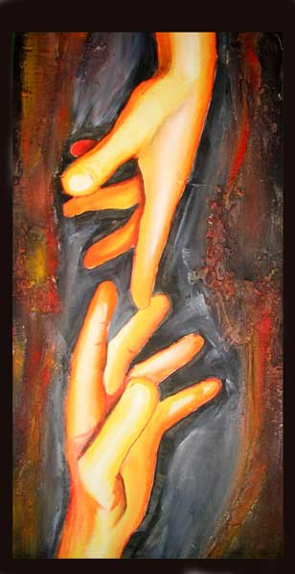
What is faith?
Q6
Q78
"Faith is believing that something is so,
when it isn't so,
so it will be so!"

Slide 81

What are those with faith like?
• Trust God
Q51, Q69
• Dreams dreams
Q24, Q60
• Not distracted by details
Q42
• Prayerful
Q33, Q87

Slide 82
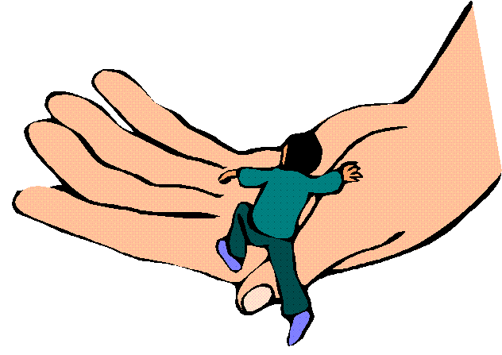
Who has the faith gift?
Notes:
82

Slide 83

Giving
57
Q7
Meets material needs
Notes:
83

Slide 84

“…if it is contributing to the needs of others, let him give generously…”
(Romans 12:8 NIV)
Q43
Q52

Slide 85
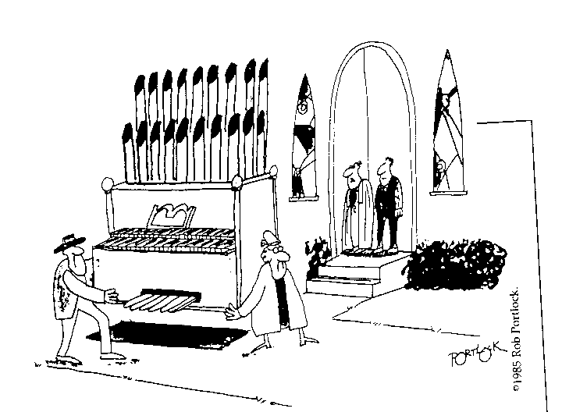
Selfish Giving
Q16
Q61
Q88
“They donated it, but they didn't care for the offertory today.”
Notes:
85

Slide 86
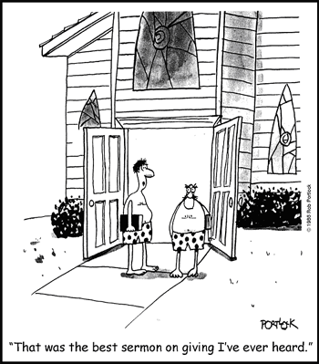
Great Preaching on Giving!
Q25
Q34
Q70
Q79
“That was the best sermon on giving I've ever heard.”
Notes:
86

Slide 87

Service
= Helps
58
Q8
Meets practical needs
Notes:
87

Slide 88

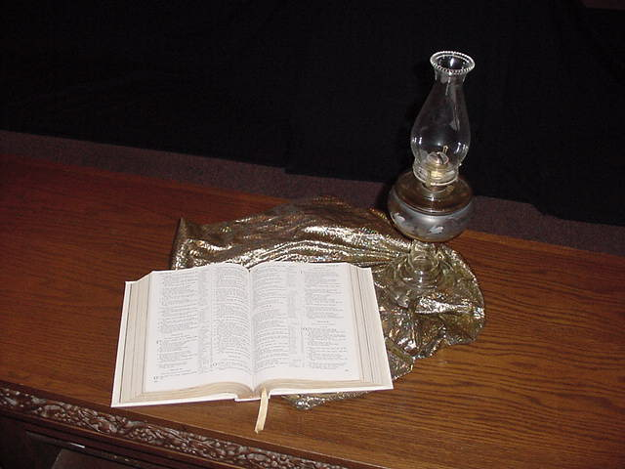
2 Timothy 1:16-18
58
Q17
“May the Lord show mercy to the household of Onesiphorus, because he often refreshed me and was not ashamed of my chains. On the contrary, when he was in Rome, he searched hard for me until he found me. May the Lord grant that he will find mercy from the Lord on that day! You know very well in how many ways he helped me in Ephesus.”

Slide 89

1 Corinthians 16:17-18
58
Q44
“I was glad when Stephanas, Fortunatus, and Achaicus arrived, because they have supplied what was lacking in you. For they refreshed my spirit and yours also. Such men deserve recognition.”

Slide 90
Servers are Vital
58
Q26
“These ministries, though often missed by the public eye, form the backbone of an effective local church. They guard the public declaration of the Word from interruption, delay and unnecessary demands. It is to be noted that all Christians are to be available to help and assist, but not all are able to do it with unending joy, ease, and efficiency.

Slide 91
Servers are Vital
58
Q17
Q44
“Most often, these folk are very observant, able to notice needs and take care of them without others having to call their attention to them. They usually loathe the limelight”
(Swindoll, 4)

Slide 92
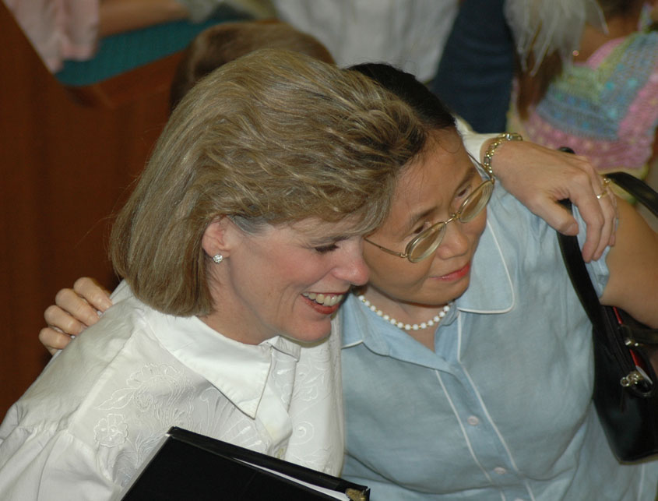
Susan
Notes:
92

Slide 93
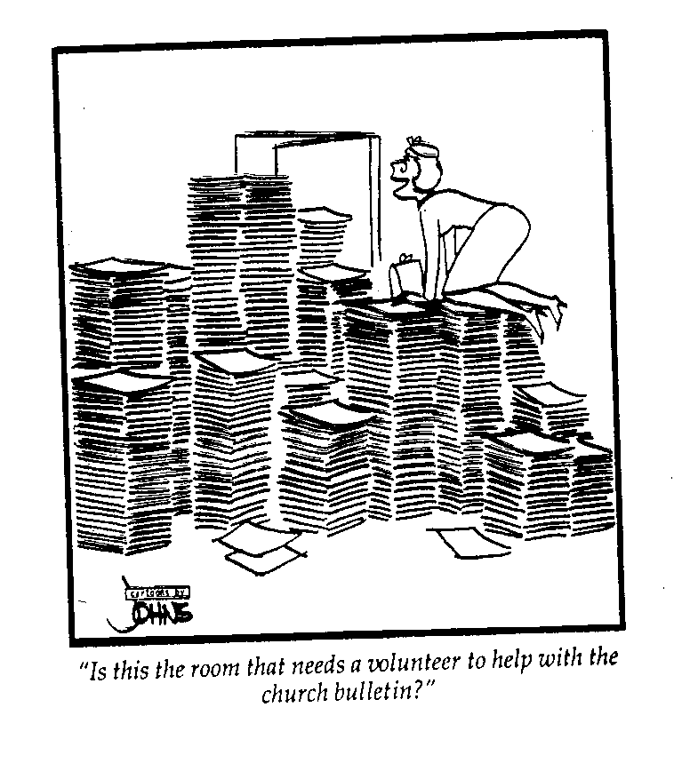
Service is Greatly Needed
Q53
"Is this the room that needs a volunteer to help with the church bulletin?"
Notes:
93

Slide 94

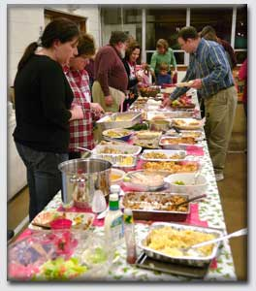



How
&
Who?
58
Q62
Q71
Q80
Q89

Slide 95

Showing Mercy
59
Q9
…meets emotional needs
Notes:
95

Slide 96

Most of us avoid "down & outers"…
Q18
Q27
Q36

Slide 97

Mercy
Q54

Slide 98

“… if it is showing mercy, let him do it cheerfully”
(Romans 12:8)
59
Q63
Q72
Q81
Q90

Slide 99
1 Peter 4:11 (NIV)
47
“If anyone speaks, he should do it as one speaking the very words of God. If anyone serves, he should do it with the strength God provides, so that in all things God may be praised through Jesus Christ. To him be glory forever and ever. Amen.”
Notes:
99

Slide 100
1 Peter 4:11 Main Idea
“If anyone serves, he should do it with the strength God provides, so that in all things God may be praised through Jesus Christ. To him be glory forever and ever. Amen.”
If you have a serving gift then serve others in God's strength for God's glory
Notes:
100

Slide 101
Categories of Gifts
(1 Peter 4:11)
Get
words
from
God
Get
strength
from
God
47
Speaking | Serving
Teaching | Administering
Evangelism | Faith
Pastor-Teacher | Giving
Encouraging | Service
 | Mercy
Notes:
101

Slide 102

Serving Gifts Contrasted
54
 | Adminis- trations | Faith | Giving | Service | Showing Mercy
Shares | Organizing Ability | Vision | Possessions | Abilities | Concern
Recipient Need Met | Leadership | Belief | Monetary | Assistance | Understand-ing
Sensitive to Needs | Managerially | Visually | Materially | Practically | Emotionally
Ministers to Those Needing | Structure | Hope | Finances & Material Things | Aid in Everyday Tasks | Comfort
General Trait | Orderliness | Confi-dence in God | Generosity | Availability | Compassion
Notes:
102

Slide 103
Break
Notes:
103

Slide 104

Which piece are you?
God wants me to…
Notes:
104

Slide 105

How can you know what gift God gave you?

Slide 106


How to Discern Your Spiritual Gifts
Salvation
65
Spirit-Filling
Spirit-Walking
See Self-Significance
Submission
Supplication
Study
Skill
Self-Correction
Self-Analysis
Satisfaction
Seek Suggestions
Selection
Strike Out
Service
Success
Switch
Surrender
Stay

Slide 107

There's a reason they're called “gifts”…

Slide 108
Can a Christian receive more than one gift?

Slide 109

Two Views on Giftedness
44
Christians Have Only One Gift
Christians Can Have Many Gifts
“Gift” singular
Body part
Concentrate
“Gift” = “A”
Symbols
NIV
NT examples

Slide 110
Speaking Gifts Contrasted
47
 | Teaching | Evangelism | Pastor-Teacher | Exhortation
Shares | Biblical Learning | Faith & Testimony | Heart & Bible | Optimism
Recipient Need Met | Scriptural Truth | Salvation & Equipping for Evangelism | Shepherding | Encouragement
Sensitive to Needs | Doctrinally | For Conversion | Spiritually (overall needs) | Spiritually (specific needs)
Ministers to Those Needing | Instruction | Saving Faith | General Spiritual Direction | Urging in Practical Steps
General Trait | Accuracy in the Word | Heart for the Lost | Shepherd Heart | Uplifts Others

Slide 111
Serving Gifts Contrasted
54
 | Adminis- trations | Faith | Giving | Service | Showing Mercy
Shares | Organizing Ability | Vision | Possessions | Abilities | Concern
Recipient Need Met | Leadership | Belief | Monetary | Assistance | Understand-ing
Sensitive to Needs | Managerially | Visually | Materially | Practically | Emotionally
Ministers to Those Needing | Structure | Hope | Finances & Material Things | Aid in Everyday Tasks | Comfort
General Trait | Orderliness | Confi-dence in God | Generosity | Availability | Compassion

Slide 112

There is no one like you!
"If you’re just like someone else, we don’t need you."
–– Dr. Howard Hendricks (1924-2013)

Slide 113

Small Group Discussion Questions
62
What did the inventory show as your gift(s)? Did you score higher in speaking or serving gifts?
Do you agree with the inventory results?
Do the others in your group agree?
What commitment will you make to the Lord to develop your gift(s)? Be specific concerning where and how you think it can be used. Share this with your group.

Slide 114
Spiritual Gifts Class Record
63
 | Teach | Evan | Pastor | Exhort | Admin | Faith | Giving | Service | Mercy
Ps Mani
Susila Mani | 6 | 2 | 1 | 4 | 7 | 7 | 8 | 5 | 3
Keren | 5 | 8 | 6 | 7 | 3 | 5 | 1 | 4 | 2
Moses | 6 | 5 | 3 | 4 | 2 | 4 | 7 | 1 | 4
Janet | 3 | 5 | 2 | 4 | 7 | 6 | 2 | 8 | 1
Ruku | 2 | 6 | 4 | 5 | 5 | 1 | 2 | 6 | 3
Sinammah | 3 | 6 | 1 | 8 | 7 | 2 | 4 | 5 | 4
Joshua | 1 | 2 | 3 | 5 | 8 | 6 | 3 | 7 | 4
Christina | 1 | 4 | 4 | 6 | 2 | 2 | 3 | 6 | 5
Rebekah | 4 | 3 | 3 | 2 | 5 | 7 | 6 | 2 | 1
Rajan | 1 | 1 | 3 | 2 | 4 | 3 | 2 | 1 | 1
Thanam | 4 | 5 | 2 | 4 | 4 | 3 | 1 | 3 | 2
Terence | 2 | 1 | 2 | 3 | 5 | 6 | 6 | 4 | 6
Sam Palraj | 1 | 6 | 3 | 7 | 5 | 4 | 8 | 9 | 2
Molly | 7 | 7 | 4 | 5 | 5 | 6 | 1 | 2 | 3
Aaron | 4 | 5 | 6 | 2 | 4 | 4 | 1 | 3 | 4
Total Scores of 1 | 0 | 0 | 0 | 0 | 0 | 0 | 0 | 0 | 0

Slide 115
Spiritual Gifts Class Record
63
 | Teach | Evan | Pastor | Exhort | Admin | Faith | Giving | Service | Mercy
Devika | 7 | 4 | 6 | 1 | 5 | 4 | 2 | 5 | 3
Rajee | 5 | 4 | 3 | 1 | 6 | 5 | 6 | 5 | 2
Rethnaraj | 1 | 2 | 4 | 4 | 6 | 3 | 2 | 5 | 7
Esther | 1 | 3 | 5 | 6 | 6 | 4 | 2 | 2 | 4
Austin | 2 | 1 | 3 | 5 | 8 | 6 | 7 | 6 | 4
Marimuthu | 6 | 5 | 1 | 7 | 8 | 3 | 4 | 4 | 2
Nanthini | 3 | 7 | 8 | 4 | 6 | 4 | 1 | 5 | 2
Krystle | 4 | 5 | 5 | 2 | 4 | 6 | 3 | 2 | 1
Jayapushpa | 2 | 5 | 2 | 3 | 2 | 1 | 3 | 4 | 3
Rhodia | 2 | 7 | 3 | 4 | 1 | 6 | 2 | 1 | 5
Irene | 3 | 5 | 2 | 2 | 4 | 5 | 3 | 1 | 2
Satish | 4 | 6 | 1 | 2 | 7 | 5 | 4 | 5 | 3
Ramayee | 2 | 1 | 2 | 1 | 4 | 3 | 1 | 2 | 1
Kesavan | 5 | 3 | 6 | 7 | 8 | 2 | 1 | 3 | 4
Tharma | 6 | 7 | 7 | 5 | 4 | 1 | 2 | 5 | 3
Total Scores of 1 | 0 | 0 | 0 | 0 | 0 | 0 | 0 | 0 | 0
Notes:
115

Slide 116
Spiritual Gifts Class Record
63
 | Teach | Evan | Pastor | Exhort | Admin | Faith | Giving | Service | Mercy
Chee Mun | 4 | 9 | 5 | 6 | 3 | 8 | 7 | 2 | 1
Gulika | 6 | 6 | 2 | 5 | 3 | 3 | 6 | 4 | 1
Anna | 3 | 5 | 6 | 7 | 1 | 2 | 4 | 7 | 5
Agnes | 4 | 7 | 6 | 7 | 4 | 1 | 2 | 5 | 3
Ruby | 4 | 7 | 6 | 5 | 3 | 2 | 2 | 1 | 4
Amutha | 4 | 4 | 5 | 7 | 3 | 1 | 2 | 6 | 2
John Khanna | 4 | 6 | 3 | 2 | 1 | 7 | 5 | 6 | 4
James Raja | 1 | 4 | 2 | 3 | 2 | 4 | 3 | 5 | 3
Therisah | 6 | 5 | 4 | 6 | 7 | 1 | 3 | 3 | 2
Lasar | 2 | 1 | 3 | 3 | 3 | 3 | 3 | 3 | 4
Veruthayam | 1 | 3 | 4 | 2 | 5 | 7 | 8 | 6 | 4
Kalaichelvy | 4 | 5 | 6 | 6 | 7 | 1 | 2 | 2 | 3
Vasanthi | 6 | 4 | 5 | 6 | 5 | 2 | 7 | 3 | 1
Joshua Alfonso | 6 | 3 | 2 | 6 | 5 | 1 | 5 | 4 | 3
Ammaponnu | 6 | 8 | 4 | 7 | 3 | 2 | 5 | 8 | 1
Total Scores of 1 | 8 | 5 | 5 | 3 | 3 | 8 | 4 | 5 | 9
Notes:
116

Slide 117

Questions & Answers

Slide 118

Holy Spirit PPT link at BibleStudyDownloads.org
Get this presentation for free!

Slide 119
Black

